Slide 1
Instructions
Make sure you have a handout to record your path through the carbon cycle.
Click “Slideshow” in the upper right to enter presentation mode.
Click your start station below.
Once at your start station, roll your dice and follow the directions based on what number you roll. Be sure to record on your handout before moving on!
  If you are instructed to move to a new station, click the station name to jump there.
  If you are instructed to Stay, record the station and roll again.
Fossil Fuels | Atmosphere | Plants on Land
Animals and Fungi | Soil | Surface Ocean
Ocean Plants and Animals | Deep Ocean | Sedimentary Rocks

Slide 2
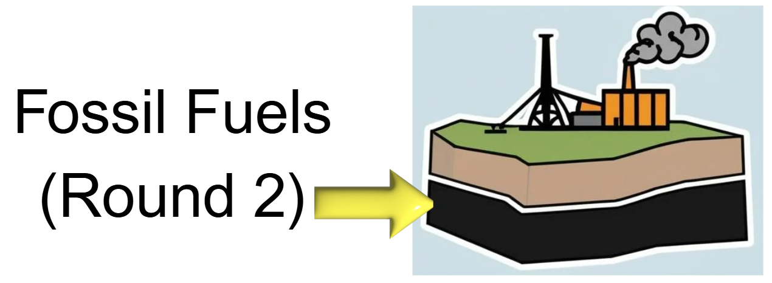
If you roll… | Move To… | Because…
1 | Fossil Fuels (Stay, Record, Roll Again) | You stay buried deep underground for a very long time.
2
3
4 | Atmosphere | People dig you up and burn you, sending you into the air as CO₂.
5
6 | Atmosphere | A little carbon leaks out through cracks or volcanoes.

Slide 3

If you roll… | Move To… | Because…
1 | Atmosphere (Stay, Record, Roll Again) | You stay in the air as CO₂ for now.
2
3 | Surface Ocean | You dissolve into the surface of the ocean.
4
5 | Plants on Land | A plant pulls you out of the air during photosynthesis.
6 | Soil | Rain carries you into the soil.

Slide 4
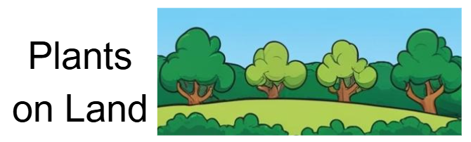
If you roll… | Move To… | Because…
1 | Atmosphere | The plant breathes out CO₂, sending you back to the air.
2
3 | Soil | The plant dies and rots, so you move into the soil.
4
5 | Plants on Land (Stay, Record, Roll Again) | You stay inside the plant for now.
6 | Animals and Fungi | An animal or fungus eats the plant and takes you in.

Slide 5

If you roll… | Move To… | Because…
1 | Atmosphere | Breathing sends you back to the air as CO₂.
2
3
4 | Soil | Waste or dead bodies rot, so you move into the soil.
5
6 | Animals and Fungi (Stay, Record, Roll Again) | You stay inside the animal or fungus for now.

Slide 6
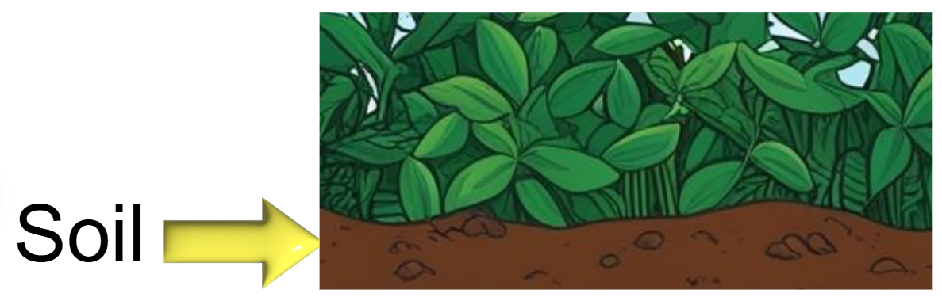
If you roll… | Move To… | Because…
1 | Soil (Stay, Record, Roll Again) | You stay stored in the soil for now.
2
3 | Atmosphere | Decomposers break things down and release you to the air as CO₂.
4 | Plants on Land | Plant roots take you up from the soil.
5 | Fossil Fuels | Over millions of years, deep burial turns you into fossil fuels.
6 | Sedimentary Rocks | More burial and squeezing change you into rock.

Slide 7

If you roll… | Move To… | Because…
1 | Surface Ocean (Stay, Record, Roll Again) | You stay dissolved in the sunlit ocean water.
2
3 | Atmosphere | You bubble out of the ocean back into the air.
4 | Ocean Plants and Animals | Ocean plants or animals take you in.
5 | Deep Ocean | Currents carry you down to deeper water.
6 | Sedimentary Rocks | Mud on the sea floor traps you and hardens into rock.

Slide 8
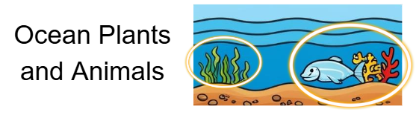
If you roll… | Move To… | Because…
1 | Ocean Plants and Animals (Stay, Record, Roll Again) | You stay inside ocean plants or animals for now.
2
3 | Surface Ocean | Breathing or waste puts you back into the surface water.
4 | Deep Ocean | The dead organism sinks, taking you deeper.
5 | Sedimentary Rocks | Shells and bones pile up and turn into rock.
6 | Atmosphere | You return to the air as CO₂.

Slide 9
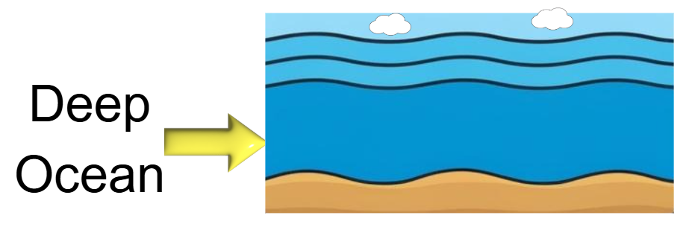
If you roll… | Move To… | Because…
1 | Deep Ocean (Stay, Record, Roll Again) | You stay dissolved in deep water for a long time.
2
3
4 | Surface Ocean | Upwelling brings you back toward the surface.
5 | Ocean Plants and Animals | Deep‑sea creatures take you in.
6 | Sedimentary Rocks | Sea‑floor mud locks you into rock for the long term.

Slide 10
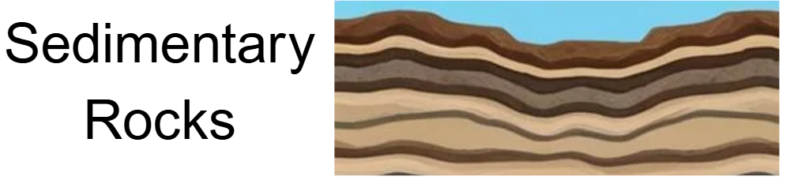
If you roll… | Move To… | Because…
1 | Sedimentary Rocks (Stay, Record, Roll Again) | You stay trapped in rock—the slowest part of the cycle.
2
3
4 | Fossil Fuels | Rarely, heat and pressure turn some rock carbon into fossil fuels.
5 | Atmosphere | Weathering or volcanoes release you to the air as CO₂.
6 | Soil | Erosion moves you from rock into the soil.

