Slide 1
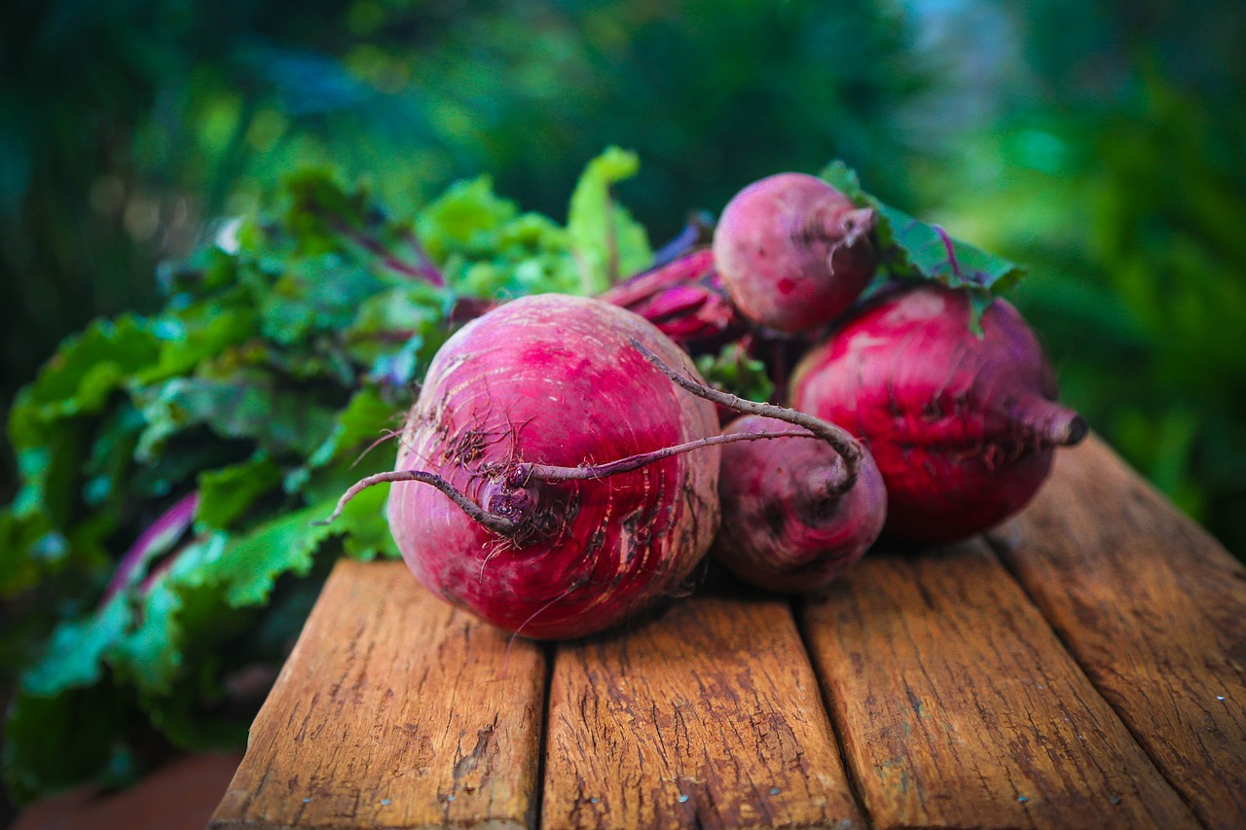
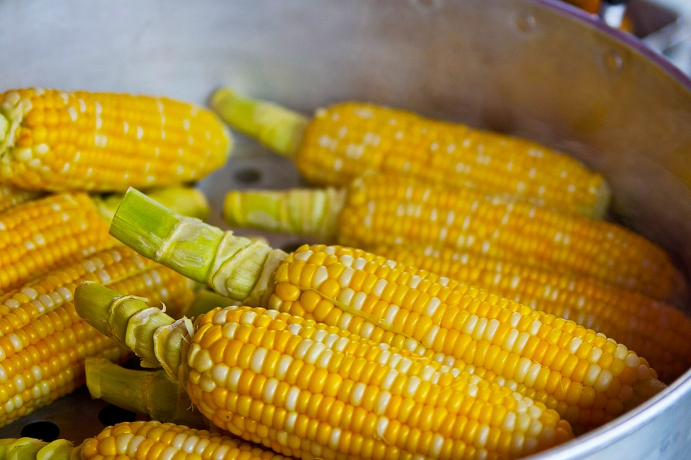
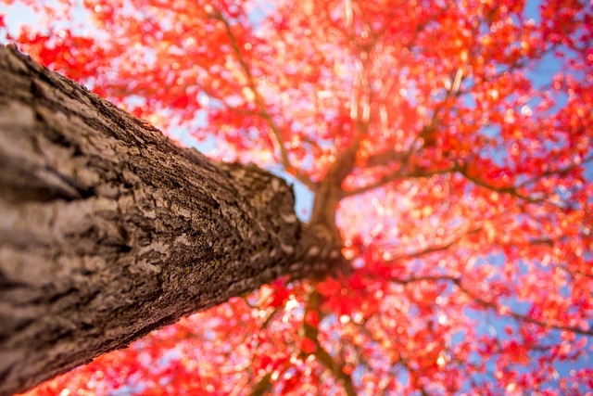
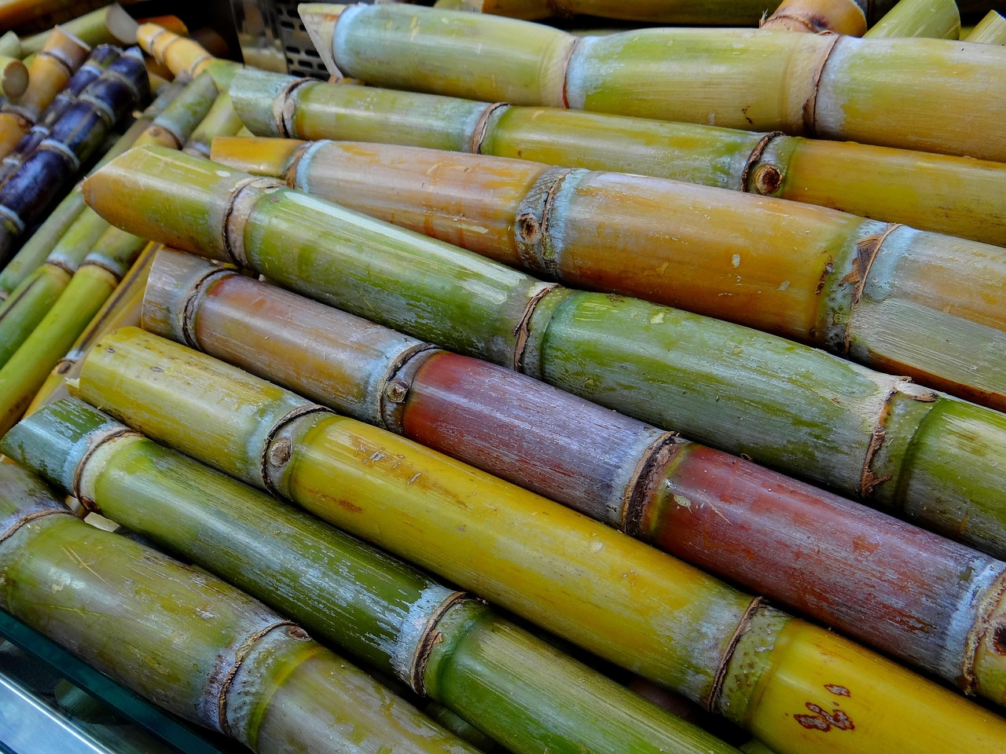
Notes:
Clockwise from upper left: Beets, Corn, Sugar Cane, and maple trees (Three very popular sources of SUGARS like high fructose corn syrup and maple syrup
All images in this slideshow were available free on Pixabay

Slide 2
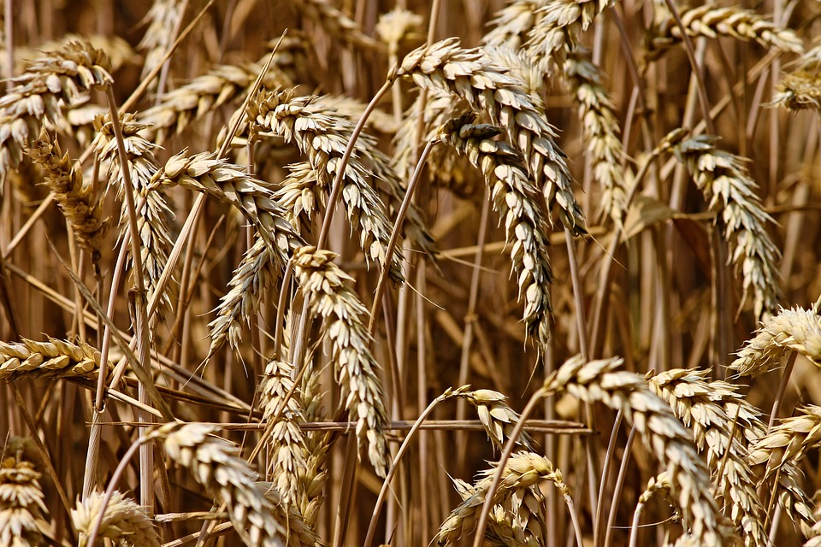
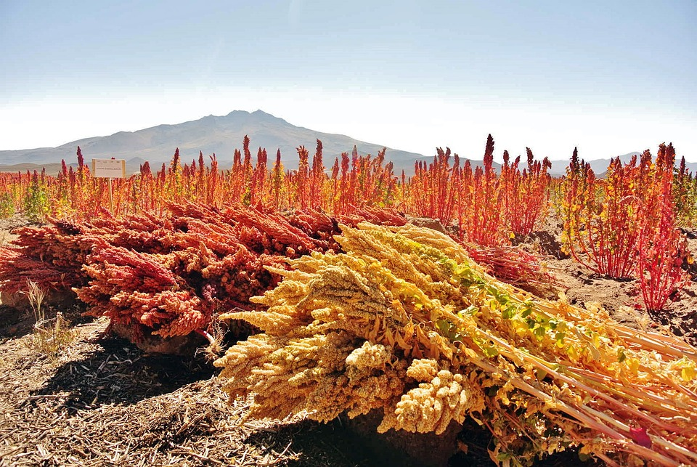
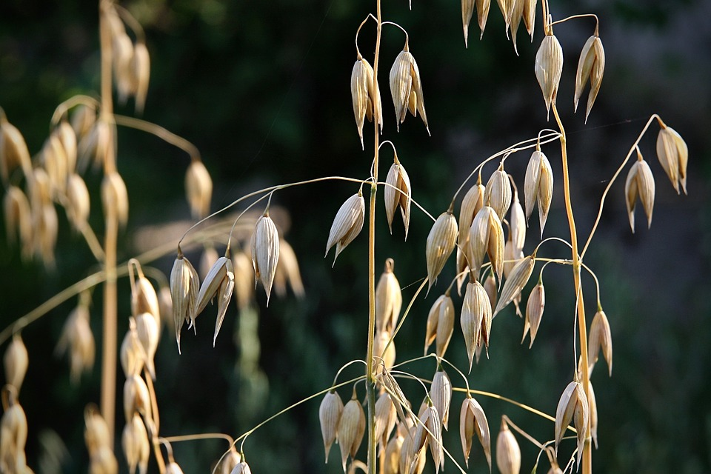
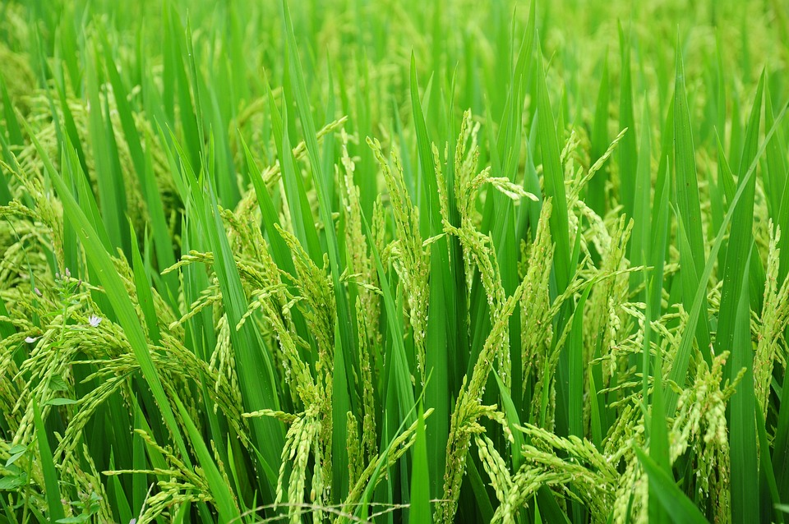
Notes:
Clockwise from upper right: Wheat, quinoa, rice, oats--common grains in things like bread, energy bars, etc.

Slide 3
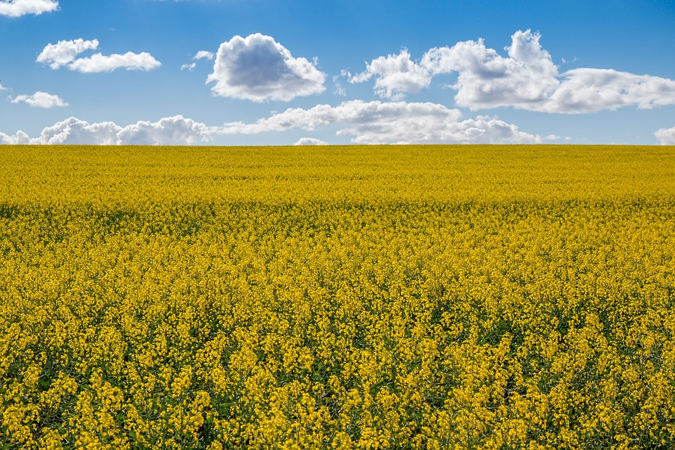
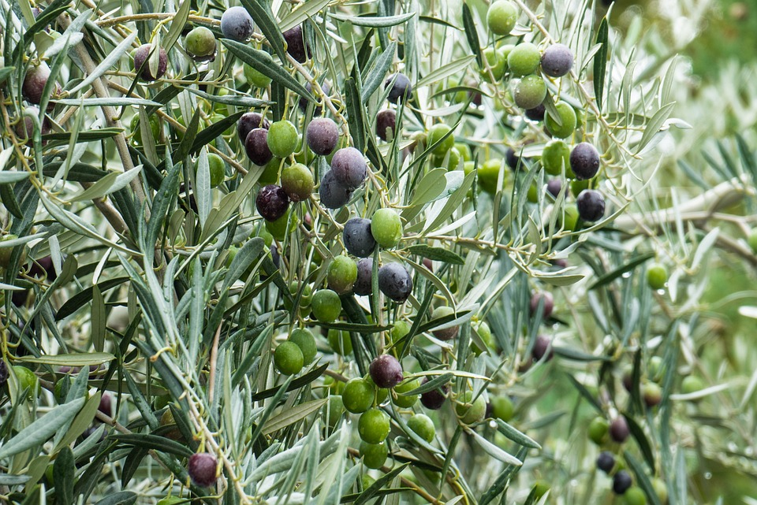
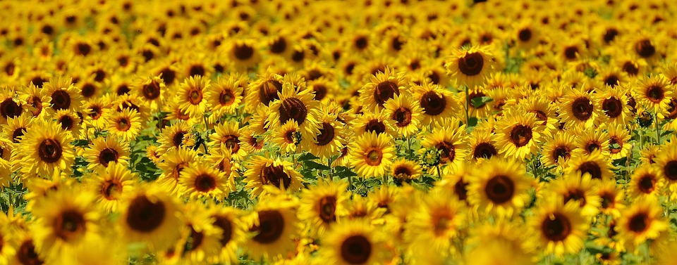
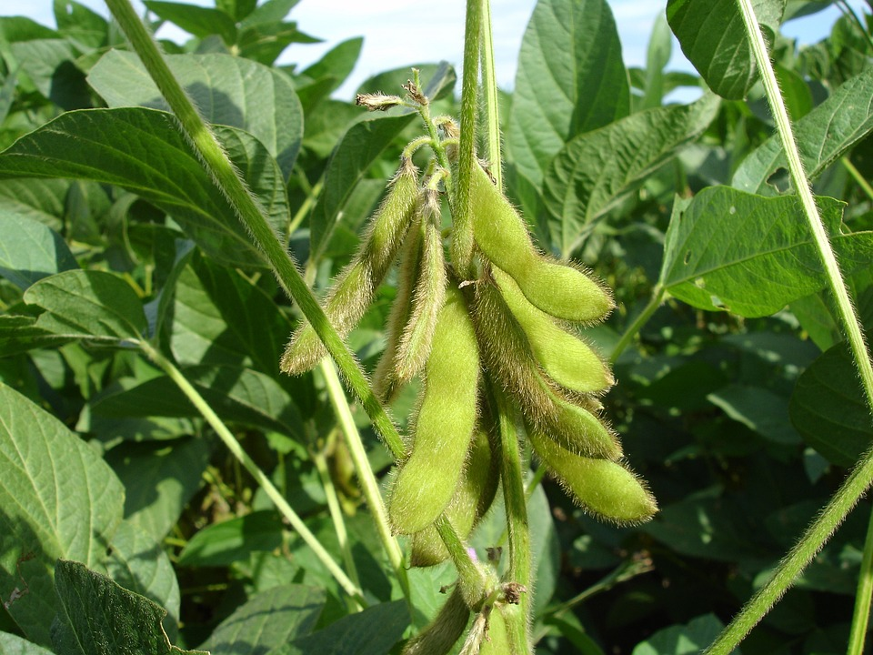
Notes:
Clockwise from upper right - canola, olives growing on a tree, soybeans, sunflowers--sources of some common sources of plant oils that we cook in and add to food.

Slide 4
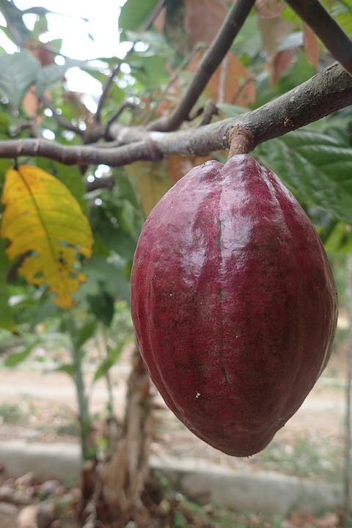
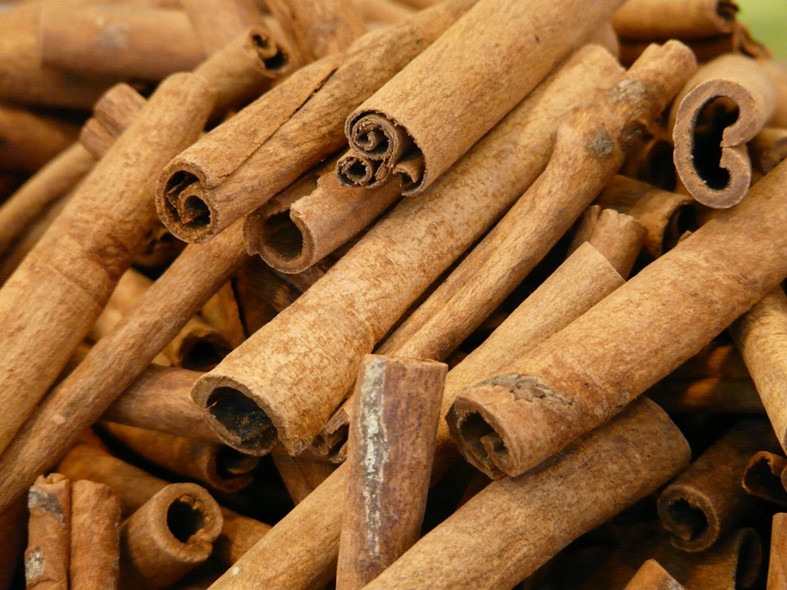
Notes:
Cacao pod --yes, chocolate comes from a plant! Small nibs inside this pod
Cinnamon sticks are the bark of a tree--the cinnamon tree. All herbs and spices--except salt!--come from plants

Slide 5
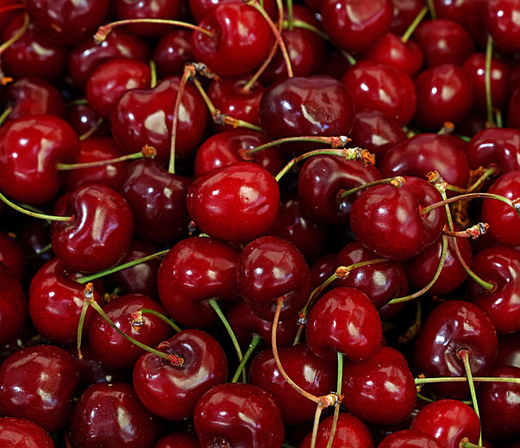
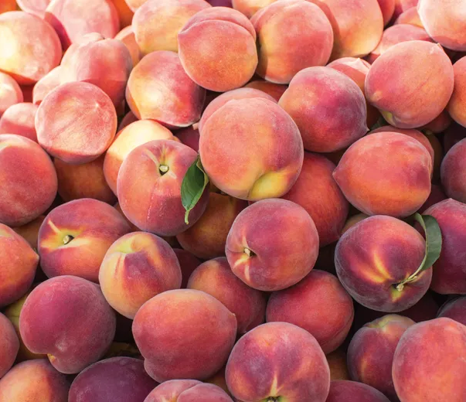
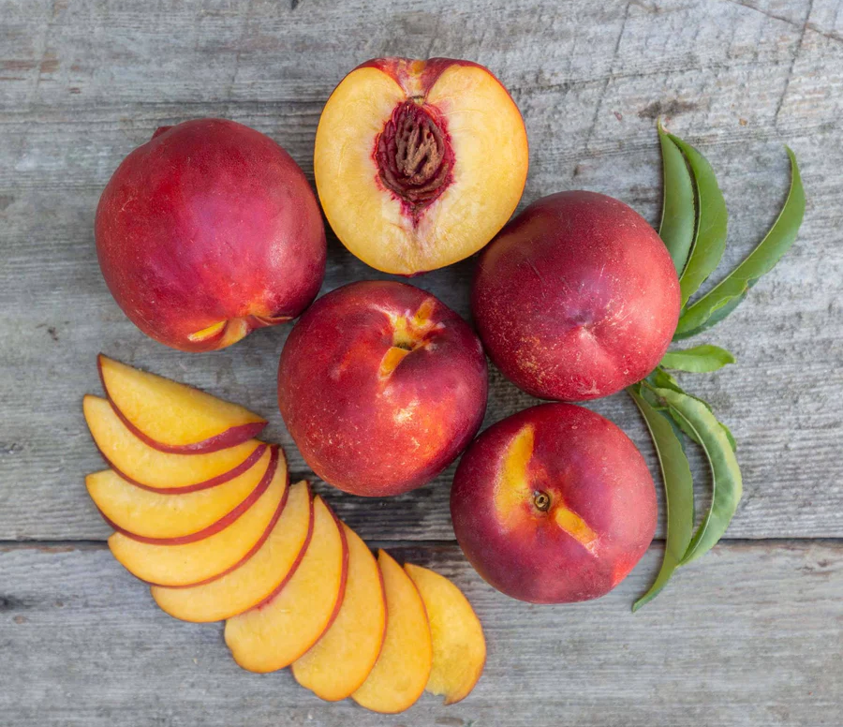
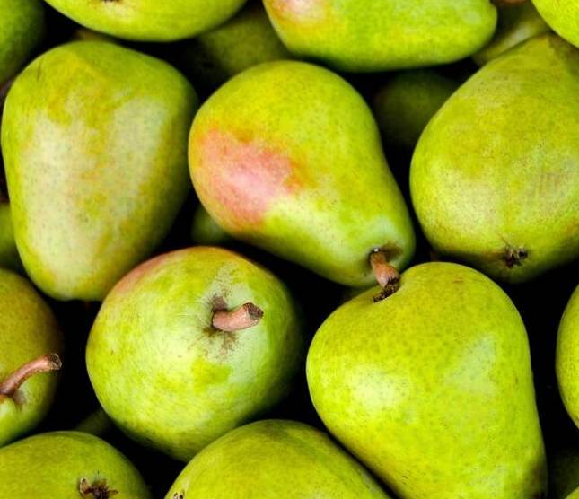
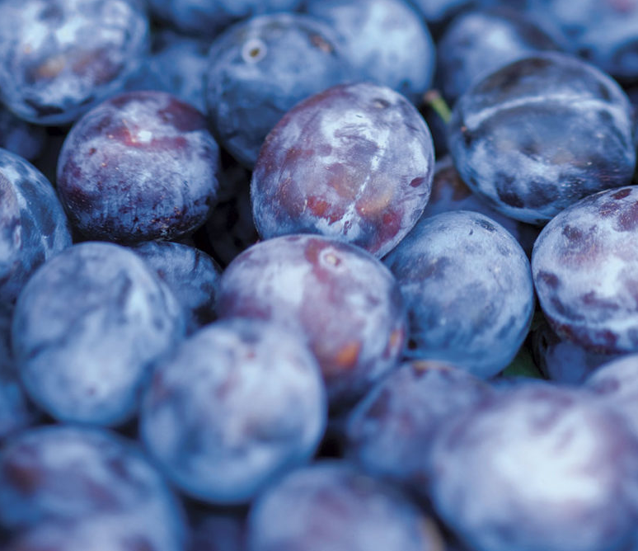
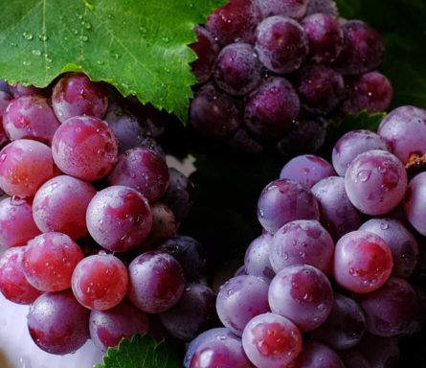
Notes:
Cherries, peaches, apricots, pears, plums, and grapes are all fruits that are rich in vitamins (A, C, K, E, B6), minerals (potassium, calcium, magnesium, iron, phosphorous), and antioxidants.

Slide 6
Pacific Northwest
Plant Examples
Use these or add your own from your region

Slide 7
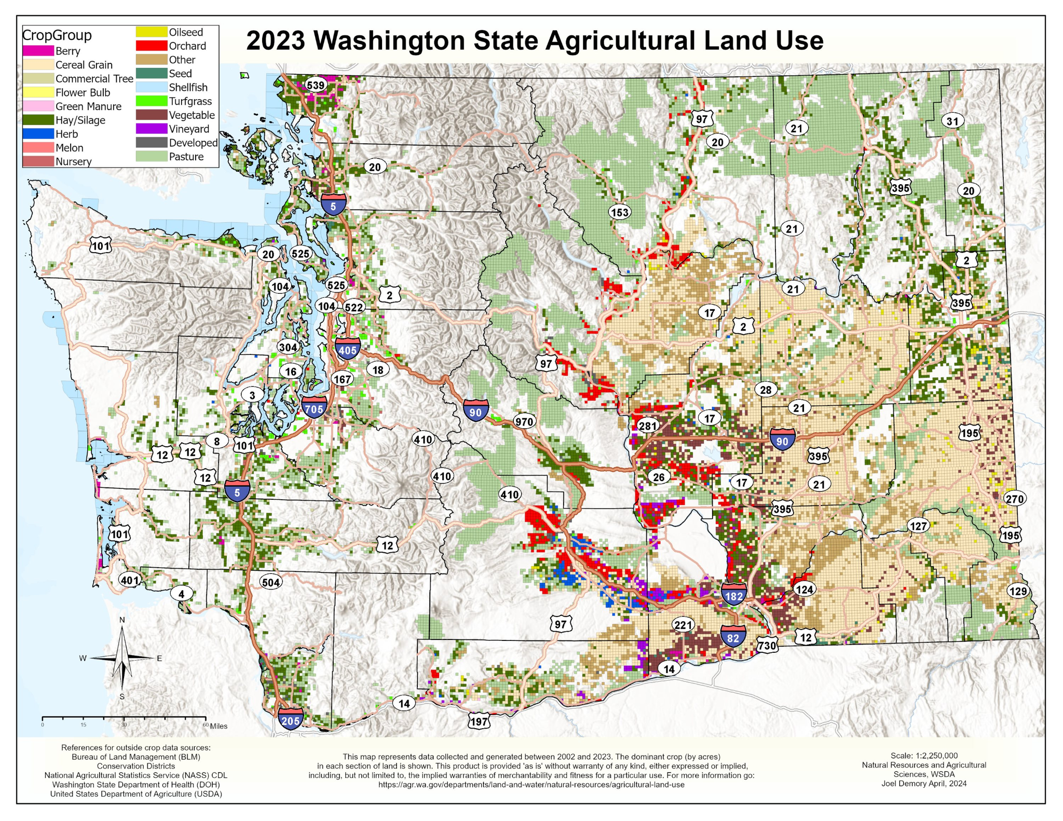
Notes:
Source: https://agr.wa.gov/departments/land-and-water/natural-resources/agricultural-land-use
Interactive Map: https://experience.arcgis.com/experience/ab85f44a941047878e54503400924388/

Slide 8

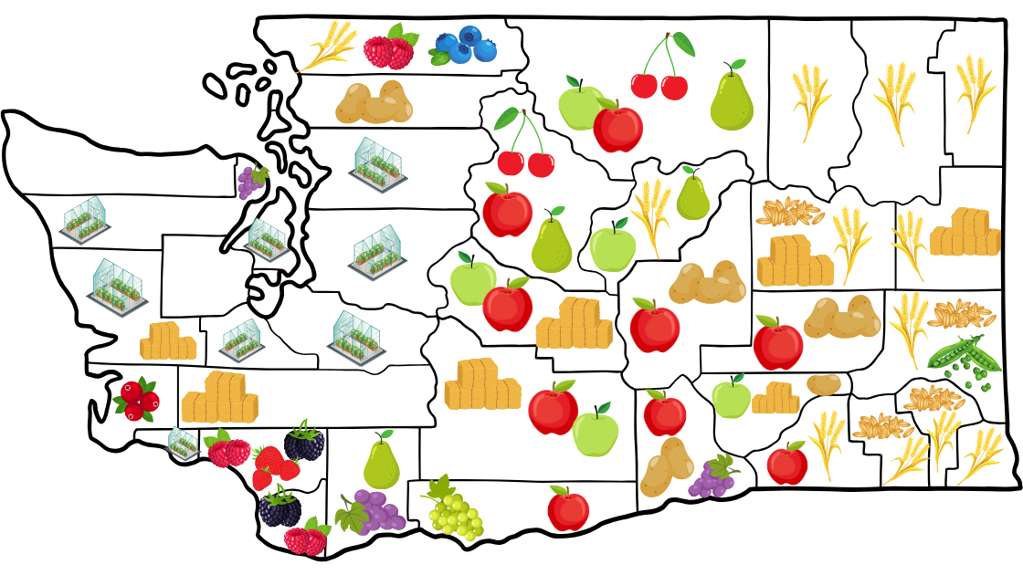
Crops Grown in Washington State

Slide 9
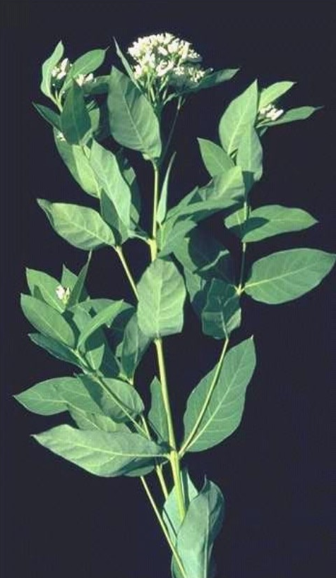
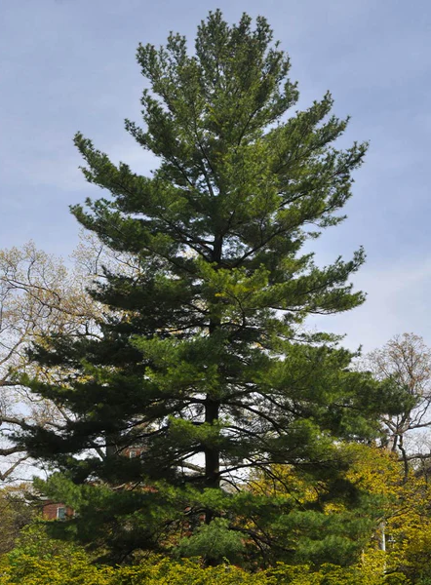
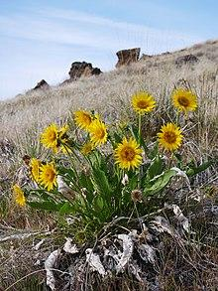
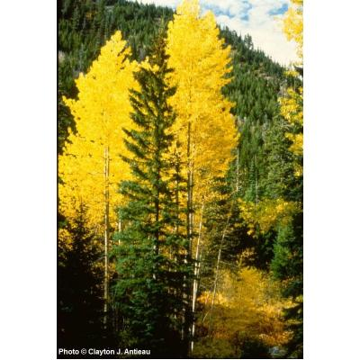
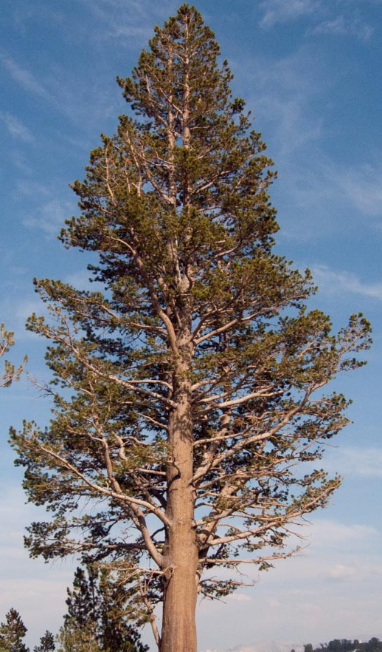
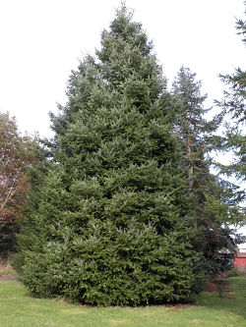
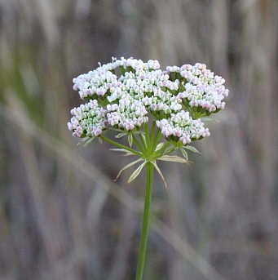
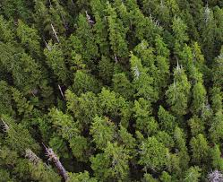
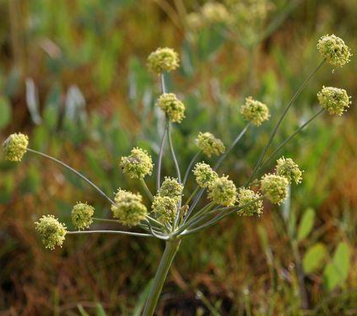
Notes:
See details about each plant on the following slides!

Slide 10

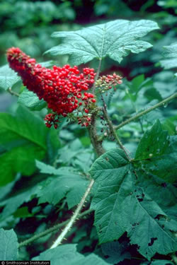
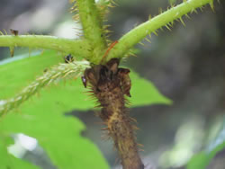
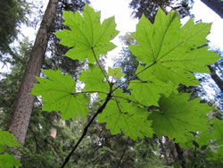
Aláala | Devil’s Club | Oplopanax Horridus
“Devil's Club is a deciduous, spiny shrub which was and still is an important medicinal plant for many Indigenous peoples in western North America. The inner bark and roots were used to treat rheumatism and arthritis, stomach and digestive ailments, tuberculosis, colds, skin disorders, diabetes, and many other ailments. Devil's club wood was also used in traditional fishing technology along the Northwest Coast and the charcoal was used as a decorative and protective pigment.”^{[1]}
Notes:
Citations:

Slide 11
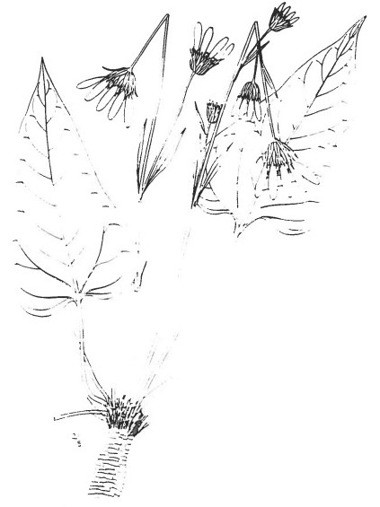
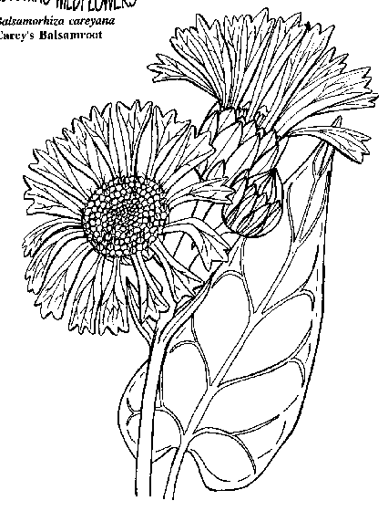
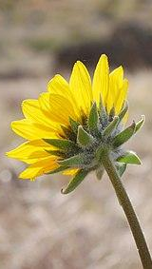
Xamsi | Balsam Root Sunflower | Balsamorhiza Careyana
“[This] plant is found in the lowlands in early spring time. The plant is picked when the flowers are budding. It has [a] velvety stem. One elder told me the roots are not eaten. “We only eat the
stems when they are fresh from the ground.” This root is set on the table after the pyaxi, breadroots, and xasya.”^{[1]}
Notes:
Citations:
https://drive.google.com/file/d/1wUhsVyGtgobDZjbBjzZMUSFTSHHfTieQ/view?usp=sharing

Slide 12
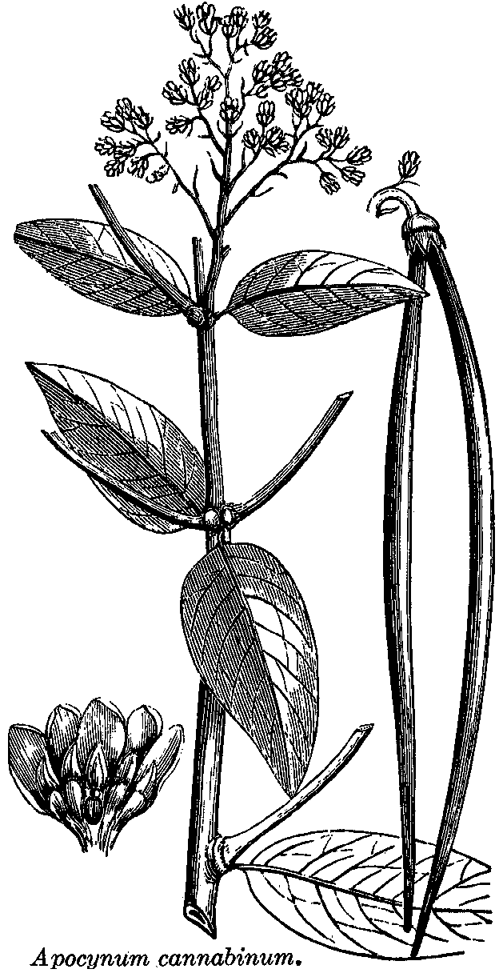
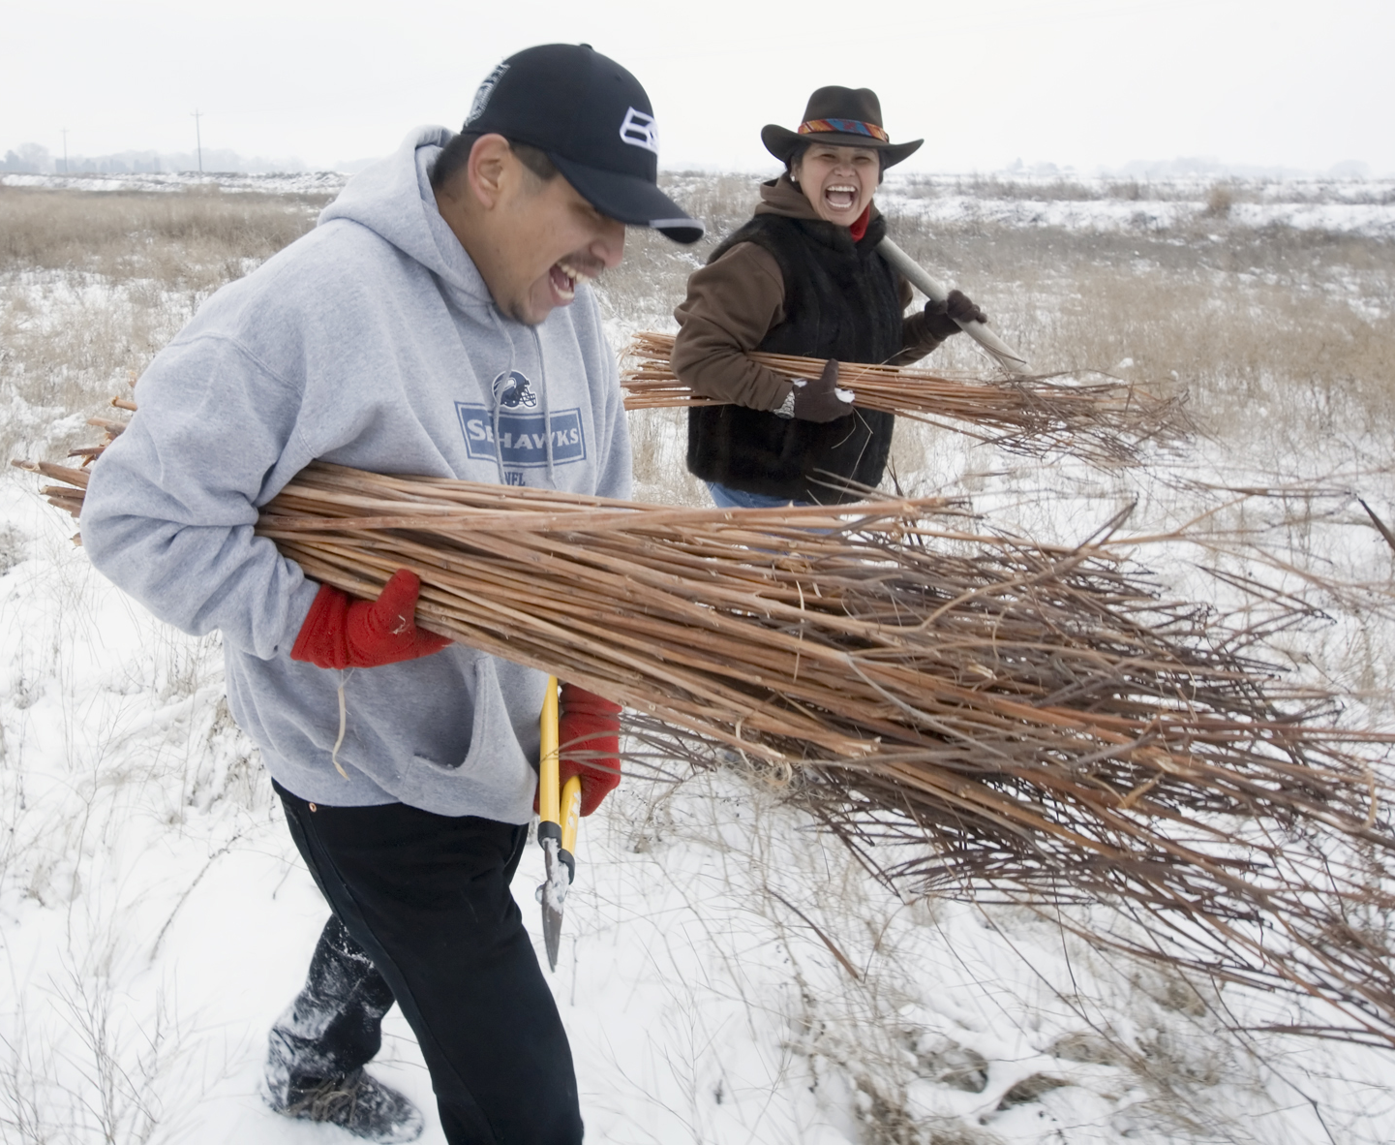
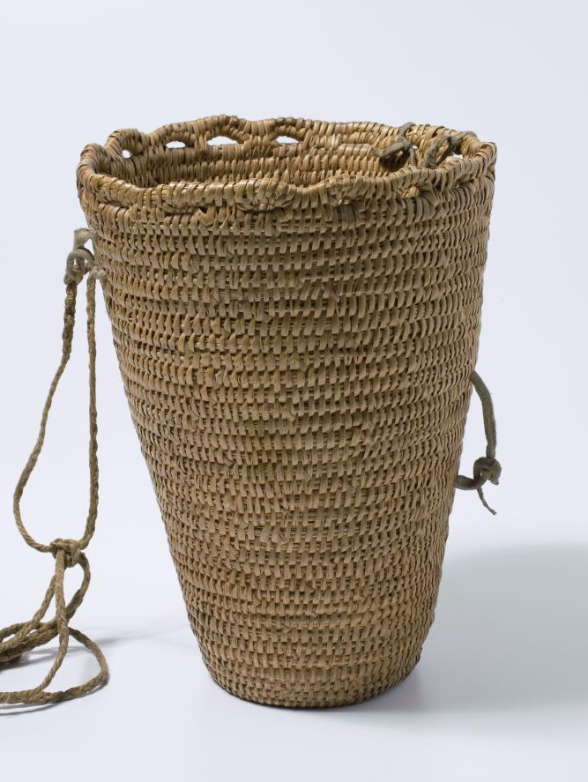
Taxus | Dogbane | Apocynum Cannabinum
Taxus is very important to tribes in the Columbia Plateau in Washington, Oregon, and Idaho.
“Taxus is harvested for fiber. The stems are cut in the fall; they are then split open and the long, silky fibers removed. The fibers are then twisted into string which provides cordage. String, thread, rope, baskets, snares, netting, and clothing was made from the bast fibers of the plant because they are so silky yet strong. Cordage was then used to make tump straps, belts, netted bags, hairnets, and ceremonial regalia (capes, skirts, and headdresses).”
Notes:
Citations:
https://www.spokesman.com/stories/2009/mar/09/living-traditions/
Dogbane: https://nativememoryproject.org/plant/dogbane/#:~:text=It%20slows%20the%20heart%20rate%20and%20strengthens%20the%20heartbeat.,inhibitors%20(blood%20pressure)%20drugs.
https://nilirc.uoregon.edu/system/files/atoms/file/Jacob%2C%20Roger%2C%202010_0.pdf
https://ethnobiology.org/node/625
https://plateauportal.libraries.wsu.edu/tags/dogbane

Slide 13
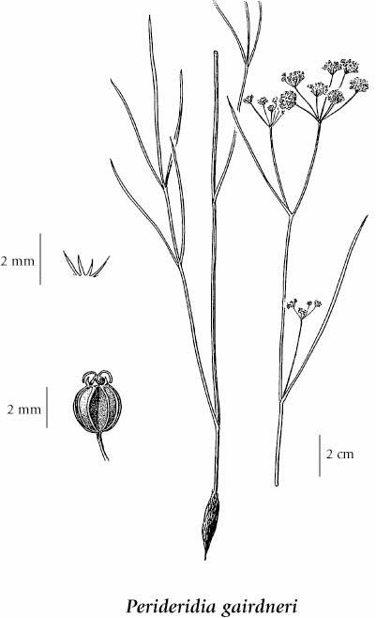
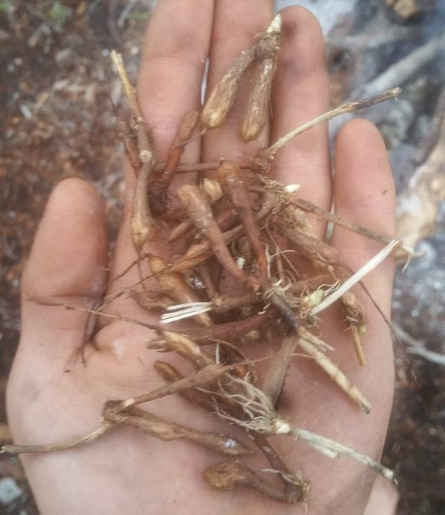
Sawítk | Wild Carrot | Perideridia Gairdneri
“This root, known as “wild carrot” on the reservation, is washed and put through a food chopper with skin intact. Using thumb and three fingers the pulp is shaped into the “three-finger” or “palm” cakes similar to those for luksh. If the pulp is dry, a little water is added for shaping. These cakes are then placed on mats made of dried cattail stems connected with twine or on clean cloths to dry. They are placed in the hot sun and turned daily so that they will dry evenly and thoroughly, then stored in airtight cans. Before the day of the food chopper or grinder, the roots were beaten into a pulp with stone mortar and pestle. This root grows in the same places as camas. “Wild carrot” also can be eaten raw or cooked as a vegetable when fresh.”^{[1]}
Notes:
Citations:
https://drive.google.com/file/d/1wUhsVyGtgobDZjbBjzZMUSFTSHHfTieQ/view?usp=sharing

Slide 14
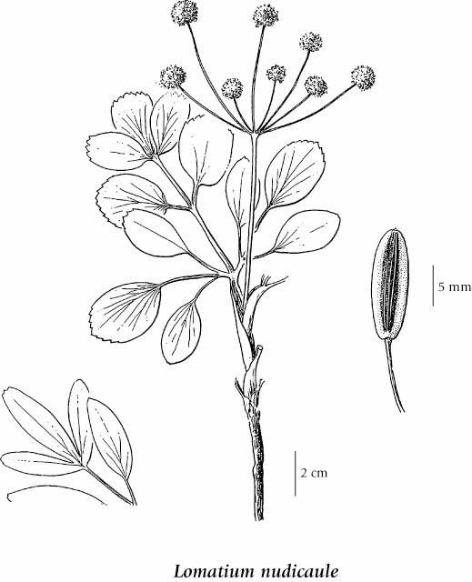
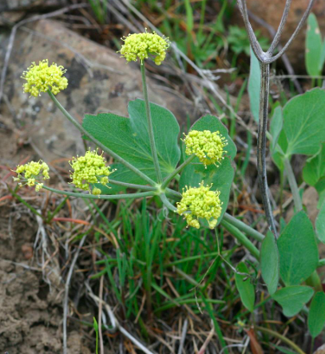
Xásya | Wild Celery | Lomatium Nudicaule
“The Wild Celery (Lomatium nudicaule) is obtained in the low hills as soon as the snow melts in the Spring. The stems [are] very succulent and they are eaten fresh. This food is not preserved because when it matures it becomes inedible. The stems are soft and have the celery smell and taste like those we purchase in the food store. Sometimes the dry seeds are used for sachet.”^{[1]}
Notes:
Citations:
https://drive.google.com/file/d/1wUhsVyGtgobDZjbBjzZMUSFTSHHfTieQ/view?usp=sharing
https://www.native-languages.org/sahaptin.htm

Slide 15
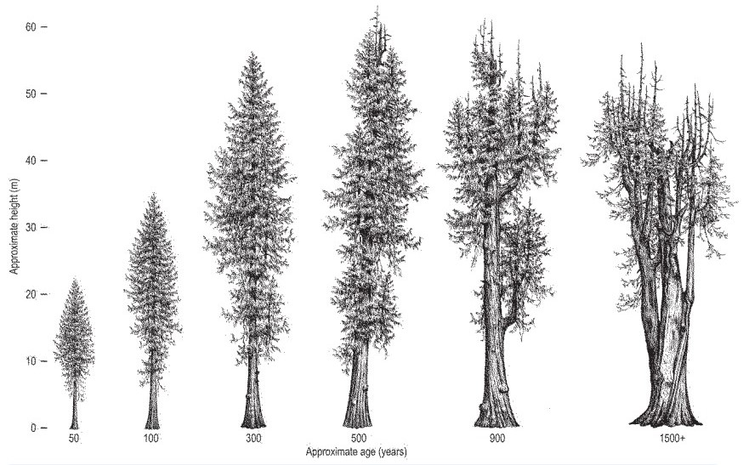
Nánk | Cedar | Thuja Plicata
“Native American tribes have relied on this plant heavily, often calling it the “tree of life”. Northwest coastal tribes have used the wood for shelters, canoes, and firewood. The limbs of the cedar tree are stripped of leaves, soaked, and twisted into ropes. Cedar limbs, bark and roots have been used for weaving baskets. The Lummi have chewed the bud for sore lungs, the Cowlitz chewed them for toothaches, and the Skokomish boiled them for a gargle. The Skagit boiled the ends of the leaves for coughs.”^{[1]}
Notes:
Citations:
https://www.wnps.org/native-plant-directory/326:thuja-plicata

Slide 16
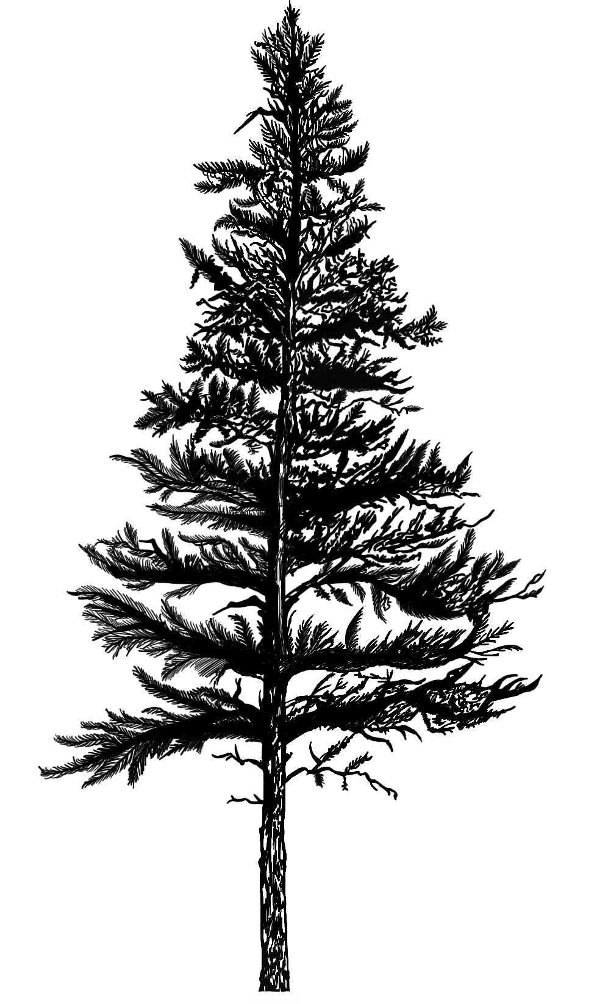
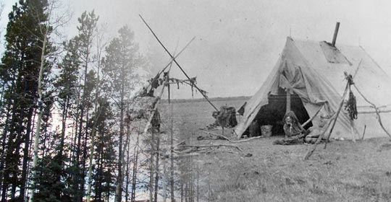
K’aláam | Lodgepole Pine | Pinus Contorta
“Indigenous communities used lodgepole pines for tipis; pitch and resin for chewing gum; and the inner cambium layer to cure tuberculosis.^{[1]} Many First Nations peoples in British Columbia used the wood from lodgepole pine for a variety of purposes, including poles for lodges, homes or buildings. In the spring, they stripped off long ribbons or "noodles" of the sweet succulent inner bark (cambium layer). It was eaten fresh in the spring, sometimes with sugar, or stored.”^{[2]}
Notes:
Blackfoot Lodgepole Pine Story
“There was once a woman named Last Calf who was riddled with Tuberculosis. While she and her husband were camped near a beaver lodge, she noticed the animal’s tracks in the mud and left some food for it. The beaver took the gift and returned the favor by appearing to her in a vision. He gave her a cure for Tuberculosis. She was to collect the pitch of the lodge pole pine, boil it in water and drink the infusion while uttering a special song. (The song had not words.) Last Calf’s husband was alarmed at this treatment and cautioned her against poisoning but she went ahead and drank the brew. She said she felt as though she were going to die and began vomiting profusely. She drank again with the same result, but the next morning her chest was cleared as never before. Then the infusion was used by everyone to treat tubercular coughs.”
Citations:
https://www.fs.usda.gov/detail/boise/learning/nature-science/?cid=fsed_009750#:~:text=People%3A%20The%20wood%20is%20used,blue%20grouse%20and%20spruce%20grouse.
https://www.for.gov.bc.ca/hfd/library/documents/treebook/lodgepolepine.htm
https://galileo.org/kainai/lodgepole-pine/

Slide 17
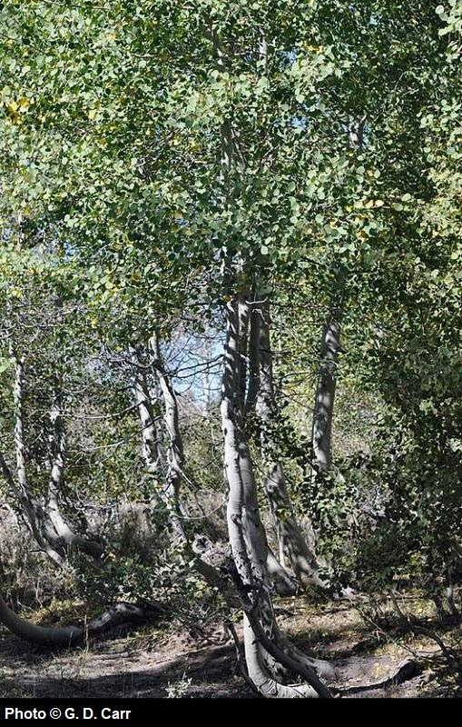
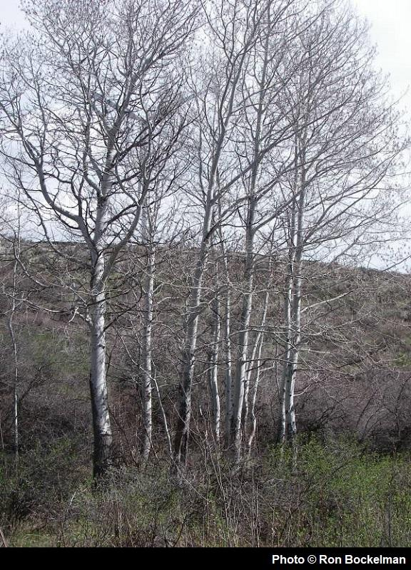
Psúni | Aspen | Populus Tremuloides
“Native tribes used to drink a tea of the bark, or use a poultice to apply to sore joints or cuts. It was even used for pain relief during childbirth. The inner bark has been dried and ground into a powder, used in a similar manner as wheat baking flour for bread or thickening soups. This tree contains compounds, salicylates that help with anti-inflammatory purposes.”^{[1]}
Notes:
Citations:
https://www.wnps.org/native-plant-directory/231-populus-tremuloides

Slide 18
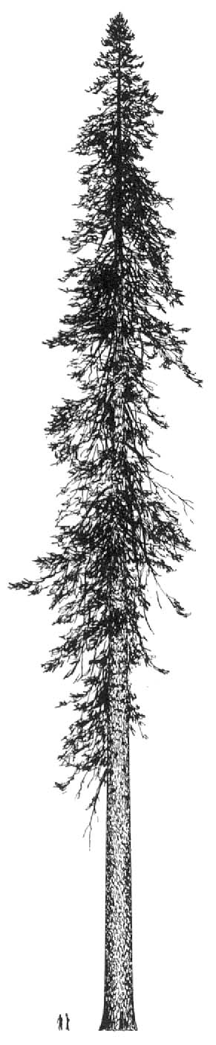



Pápsh | Grand Fir | Abies Grandis
“Medicinally, teas were made for colds, crushed and dried needles were used as baby powder, and boughs were brought inside to burn as incense and ward off illness. Pitch (sap) could be mixed with oils and used as a deodorant or to prevent hair loss. The needles were crushed and mixed with tree bark to make a tonic which could aid internal injuries.” ^{[1]}
Notes:
Citations:
https://mapping.uvic.ca/section/grand-fir
https://www.conifers.org/pi/Abies_grandis.php
https://herbaria.plants.ox.ac.uk/bol/plants400/Profiles/ab/abies

Slide 19



Sáxi or Táp’ash | White Pine | Pinus Monticola
The gum and pitch were used for cough medicine.^{[1,2]} Pitch was also used for sores^{[3]} and stomach aches.^{[2]} The wood was also used for ceremonial items like small totem poles and model canoes.^{[4]}
The bark was used by Okanagan-Colville tribe to make sturgeon nosed canoes.^{[5]} The Skagit Tribe used a decoction of bark for cuts and sores and an infusion of bark for tuberculosis.^{[6]}
J.R. Bluff, a Kalispel Indian, paddles a traditional canoe on Lake Pend Oreille (Photo by Robert C. Betts
Notes:
Citations:
Reagan, Albert B., 1936, Plants Used by the Hoh and Quileute Indians, Kansas Academy of Science 37:55-70, page 58
Reagan, Albert B., 1936, Plants Used by the Hoh and Quileute Indians, Kansas Academy of Science 37:55-70, page 58
Turner, Nancy Chapman and Marcus A. M. Bell, 1973, The Ethnobotany of the Southern Kwakiutl Indians of British Columbia, Economic Botany 27:257-310, page 270
Turner, Nancy J., John Thomas, Barry F. Carlson and Robert T. Ogilvie, 1983, Ethnobotany of the Nitinaht Indians of Vancouver Island, Victoria. British Columbia Provincial Museum, page 73
Turner, Nancy J., R. Bouchard and Dorothy I.D. Kennedy, 1980, Ethnobotany of the Okanagan-Colville Indians of British Columbia and Washington, Victoria. British Columbia Provincial Museum, page 29
Gunther, Erna, 1973, Ethnobotany of Western Washington, Seattle. University of Washington Press. Revised edition, page 16
http://indigenousboats.blogspot.com/2011/09/sturgeon-nose-canoes.html
http://naeb.brit.org/uses/search/?string=Pinus+monticola
https://ucjeps.berkeley.edu/eflora/eflora_display.php?tid=38285
https://depts.washington.edu/treetour/46_wwpine.html

Slide 20
TEMPLATE SLIDE
Indigenous Name | Common Name | Scientific Name
Body Paragraph: In this paragraph you should include the information you know about the plant. You may wish to do some research online or interview local community experts. Examples of information to include are - when and where does it grow, what relationships does it have (who eats it/who does it sustain, what does it “eat”/what sustains it, what gifts does it provide/how do we use it, and are the answers to these questions always the same or do they change with time/the seasons.
If possible, insert your own scientific drawing of the plant. With labels,
measurements, and notes.
If possible, insert photos you
took of the plant.
You may want to consider doing a
class field trip to allow students
to find local plant samples.

